Slide 1
Supervised Learning Quiz

Slide 2
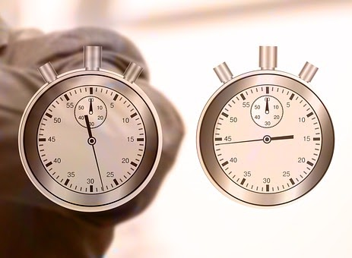
Training
It takes equally long to train a Supervised Learning model as it takes to use it inside an application.
True
False

Slide 3
Training
It takes equally long to train a Supervised Learning model as it takes to use it inside an application.
True
False

Slide 4
Training
Depending on the type of algorithm and the size of the training data, training the model usually takes from few seconds up to multiple days (or even weeks). Using it however is a matter of milliseconds.

Slide 5
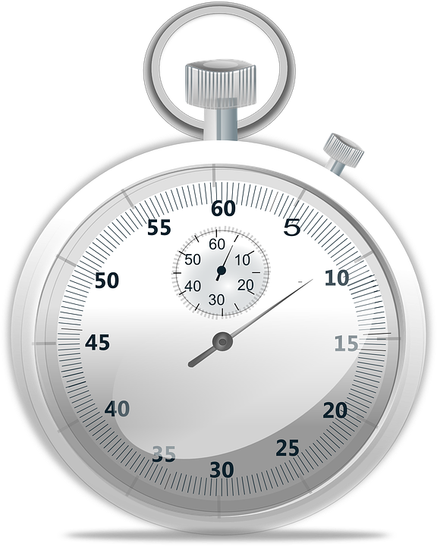
Models
Pre-trained models drastically reduce the time required to train a Supervised Learning model.
True
False

Slide 6
Models
Pre-trained models drastically reduce the time required to train a Supervised Learning model.
True
False

Slide 7
Models
While the training process can be quite long, a lot of it can be done beforehand so that the model only needs to be adapted to the new data. This drastically reduces the required training time.
Teachable Machine uses pre-trained models, otherwise the training would take much more images and the results would most likely be less accurate.

Slide 8
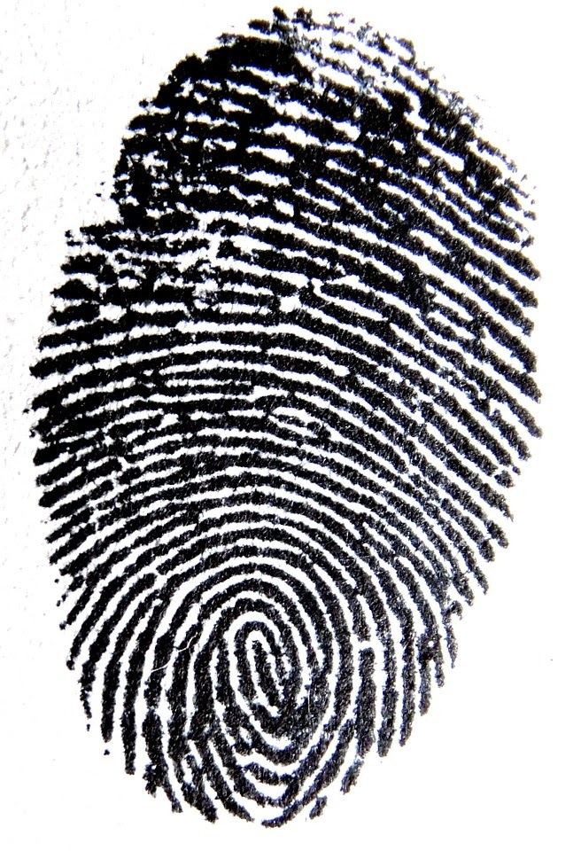
Fingerprints
Fingerprint scanners use Supervised Learning to detect and differentiate between different persons.
True
False

Slide 9
Fingerprints
Fingerprint scanners use Supervised Learning to detect and differentiate between different persons.
True
False

Slide 10
Fingerprints
Fingerprint scanners use pre-trained networks to detect features unique to each person
As the network is already trained using it is very fast (it only has to decide if the recognized features are similar enough)

Slide 11
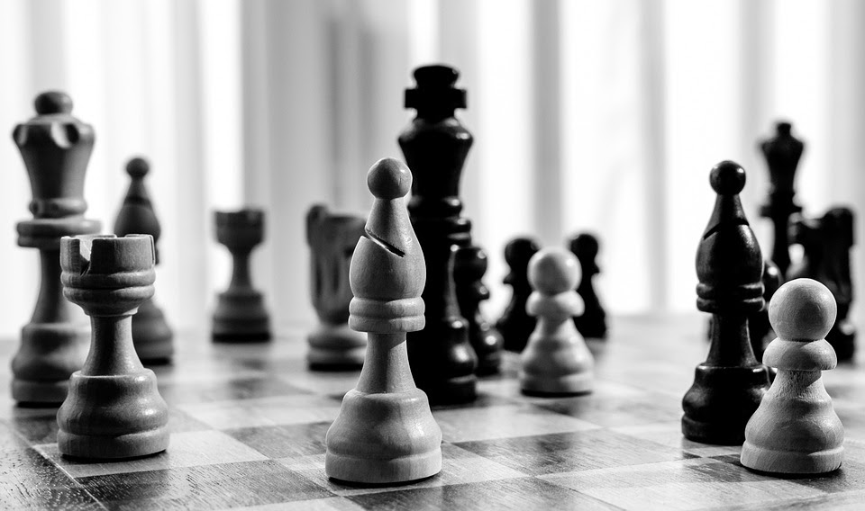
Chess
Modern chess-computers use Supervised Learning to always make the best move.
True
False

Slide 12
Chess
Modern chess-computers use Supervised Learning to always make the best move.
True
False

Slide 13
Chess
Chess has too many different board states (roughly 10⁴⁴) to use for classical training
These kind of problems are typically solved using Reinforcement Learning (letting the AI play millions of games and give rewards depending on performance)

Slide 14
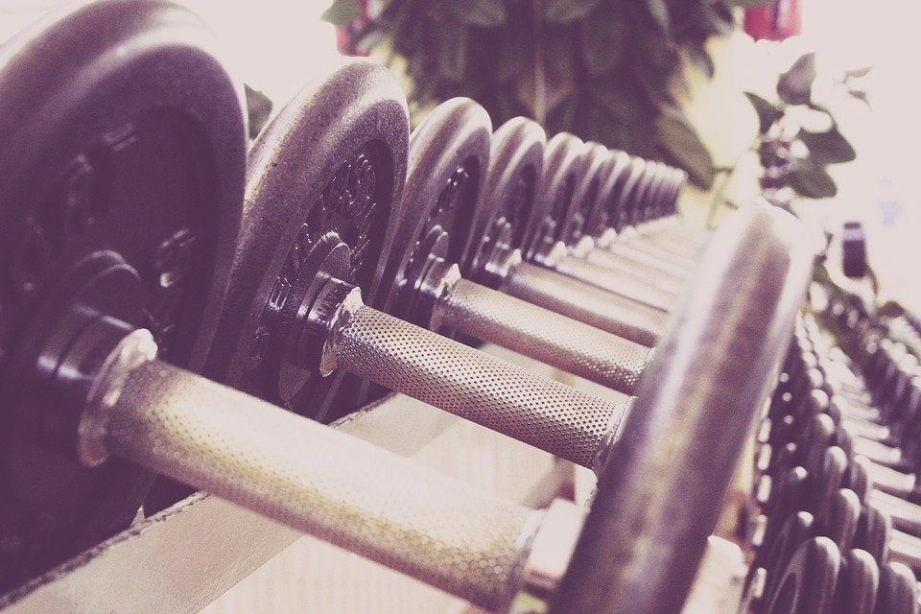
Training
During training, the following part of a Supervised Learning Algorithm is changed automatically
the algorithm itself
the model
the parameters
the labelled data

Slide 15
Training
During training, the following part of a Supervised Learning Algorithm is changed automatically
the algorithm itself
the model
the parameters
the labelled data

Slide 16
Training
During training only the model is changed
When changing anything else (parameters, training data), the training usually has to start from the beginning

Slide 17
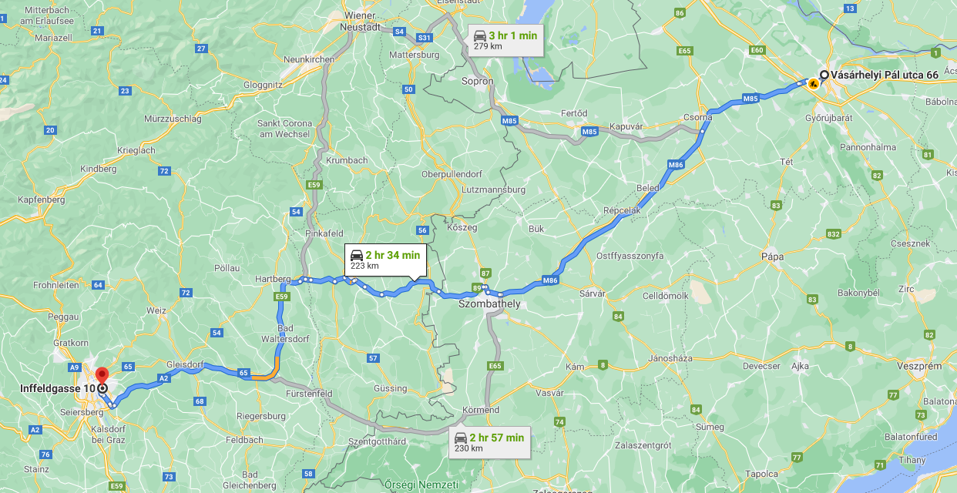
Pathfinding
Google Maps uses Supervised Learning to find the best route to the destination.
True
False

Slide 18
Pathfinding
Google Maps uses Supervised Learning to find the best route to the destination.
True
False

Slide 19
Pathfinding
How would you even pick a trainings set? (there are ‘near infinite’ possible routes, even more than possible chess positions)
Finding the shortest path can efficiently be solved by informed search algorithms (e.g. A*)

Slide 20
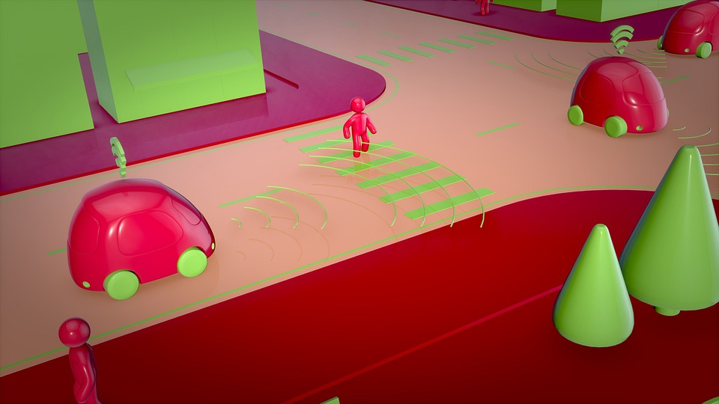
Self driving cars
A self driving car can use Supervised Learning to track and classify surrounding objects.
True
False

Slide 21
Self driving cars
A self driving car can use Supervised Learning to track and classify surrounding objects.
True
False

Slide 22
Self driving cars
Self driving cars are very complex and use many different algorithms for different tasks
Supervised Learning is only used in some parts like object classification

Slide 23
Do you have further examples of or questions about Supervised Learning?

